Slide 1
Biomedical Student Presentation
Examples and Style Guides

Slide 2
All Text is Arial & Headers are 40 pts
Subheads are Orange Bold and 28 pts
  Body copy is 24 pts and can be bulleted or not
    Secondary copy is 20 pts
    Footers, Slide numbers and Date/Time can be turned on by going to Insert>Header and Footer and turning them on or off as needed

Slide 3

Square Image

Slide 4
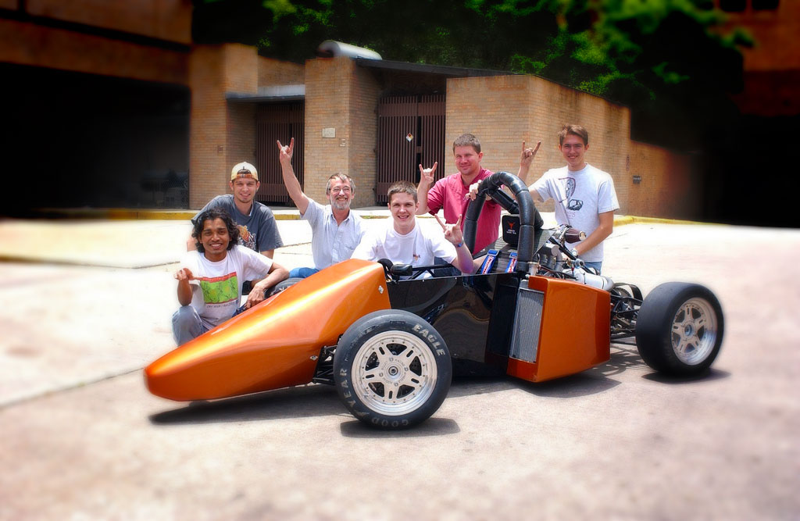
Examples of layouts

Slide 5
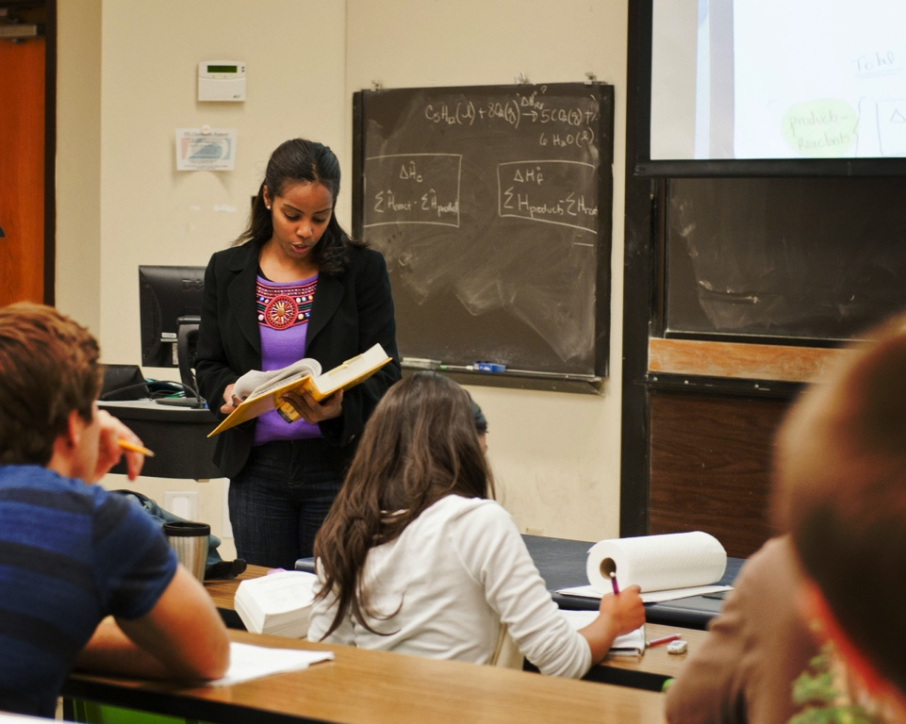
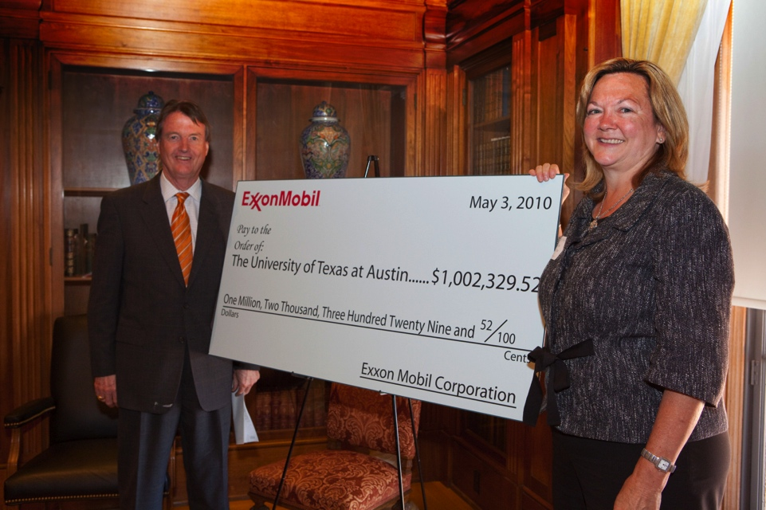

Photo Collage Option

Slide 6
Photo Collage Option
Three Pictures, No Distortion

Slide 7


Multiple Collage Choices

Slide 8
Images & Text
Image Layout Options
  Lets move to another level
  Get some bullets up in here
  So nice and readable

Slide 9
Example of a Default Pie Chart

Slide 10
Example of Default Column Chart

