Slide 1

CSE Leadership Presentations
Template and Style Guides
Notes:
You should use a cover that is most appropriate for your talk. Just delete this image by selecting it and pressing the delete key, then select the button in the middle of the page and link to the file that you would like to use instead.

Slide 2
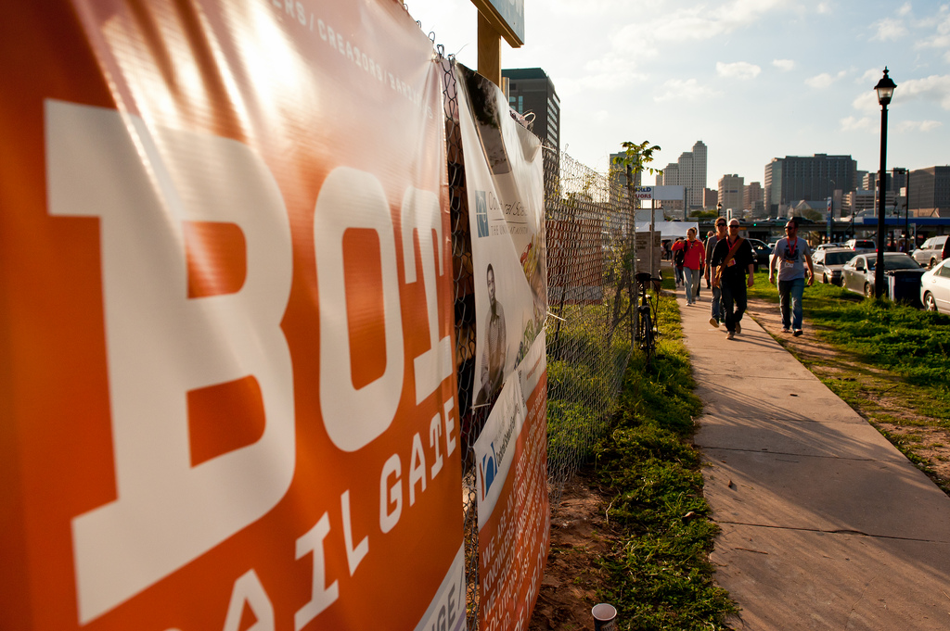
Big Pictures Are Nice
Drag and drop from our flickr site. Use “Large 1024” to reduce pixilation on full screen images. *See notes
Notes:
http://www.flickr.com/photos/cockrellschool/sets/
http://www.flickr.com/photos/utaerospace/sets/
http://www.flickr.com/photos/utbme/sets/

Slide 3
Gradients
Use the provided black to transparent gradient (see below) if your image is too “busy” to easily read the text. This gradient can be copied and pasted to other slides but be sure to layer them ABOVE the image and BELOW your text. They can be stretched vertically to accommodate the amount of text in your slide but should always take up the entire width of the slide. You can copy and paste the gradient from this page as needed.
Used to Increase Legibility

Slide 4

Framed Pictures
Use “simple frame, white” picture style and change the line weights to 2 ¼ pt.

Slide 5
Standard Headers are 44 pt
Subheads are Bold at 32 pt
Body copy can be bulleted or not
Text will resize automatically but should stay above 20 pt as a rule
Secondary copy will automatically be a bit smaller than primary copy
Same with the lower levels.
You can bold small text to increase legibility (in a chart or table for example)
This Vs. This

Slide 6
Color Palette
The CSE color palette is the default color palette for this theme and template.
Strict adherence to the CSE color palette creates unity and harmony throughout your presentation.
Contrast is the most important part in picking colors. High contrast increases legibility and calls more attention. Low contrast does the opposite.

Slide 7
Footers and Slide #s
The main branded footer will be embedded in the slide master.
Additional footers and slide numbers can be turned on by going to Insert>Header and Footer and turning them on or off as needed.

Slide 8
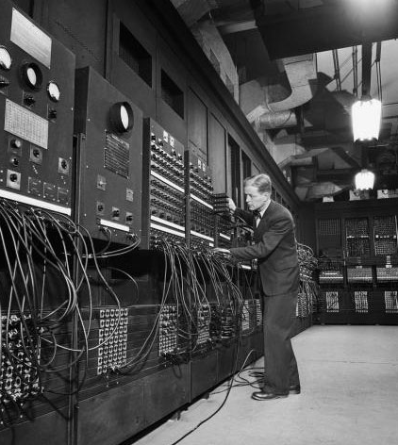
Layout Options
Look at this layout
See the Hierarchy?
1st level = Bold, no bullets
2nd level = Standard weight with bullets
3rd level = Dashes
Get the idea?

Slide 9
Example of Column Chart

Slide 10
Example of a Pie Chart

